Slide 2
Wi-Fi WPA/WPA2 Disclaimer
https://www.linkedin.com/company/wocsa/ https://www.youtube.com/@WOCSA-rx2mn/
Disclaimer
The following demonstration is for educational purposes only.
We do not promote or encourage illegal activities.
Knowing your enemy is a half-won battle
La connaissance n'est réellement profitable que lorsqu'elle est partagée
https://github.com/wocsa

Slide 3

Wi-Fi WPA/WPA2 Agenda
https://www.linkedin.com/company/wocsa/ https://www.youtube.com/@WOCSA-rx2mn/
What is the Wi-Fi WPA/WPA2?
How works a WPA/WPA2 password cracking?
Why would attackers' attacks WPA/WPA2 Wi-Fi?
How to protect yourself from WPA/WPA2 password cracking attacks?
https://github.com/wocsa

Slide 4
What is the Wi-Fi WPA/WPA2?
12/09/2024

Slide 5
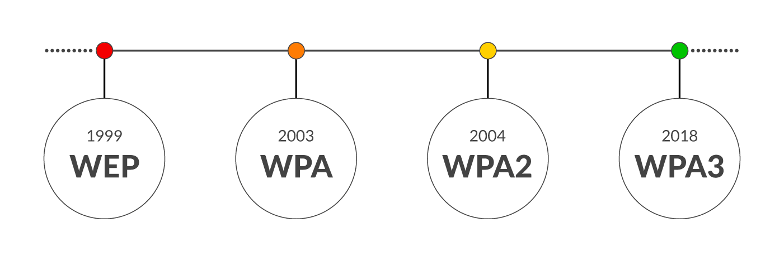
Wi-Fi WPA/WPA2 What is the Wi-Fi WPA/WPA2?
https://www.linkedin.com/company/wocsa/ https://www.youtube.com/@WOCSA-rx2mn/
https://github.com/wocsa

Slide 6
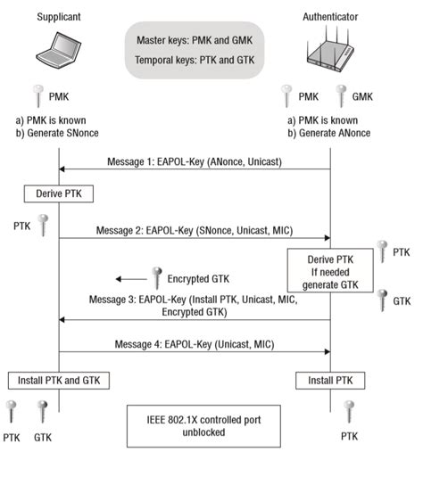
Wi-Fi WPA/WPA2 What is the Wi-Fi WPA/WPA2?
https://www.linkedin.com/company/wocsa/ https://www.youtube.com/@WOCSA-rx2mn/
The 4-way handshake involves:
The AP sending a random number (ANonce) to the client.
The client responding with its random number (SNonce).
The AP calculating the PTK from these numbers and sending an encrypted message to the client.
The client decrypting this message with the PTK, confirming successful authentication.
Post-handshake, the established PTK is used for encrypting unicast traffic, and the Group Temporal Key (GTK) is used for broadcast traffic.
https://github.com/wocsa

Slide 7
How works a WPA/WPA2 password cracking?
12/09/2024

Slide 8
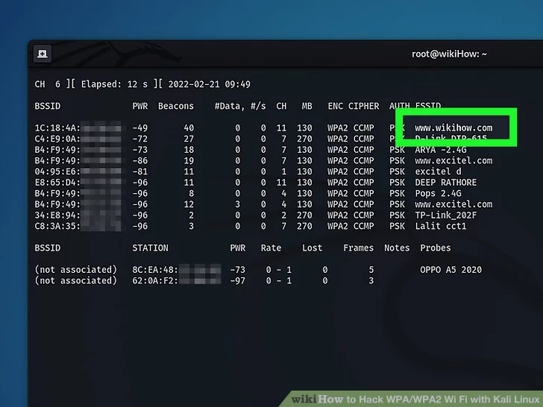
Wi-Fi WPA/WPA2 How works a WPA/WPA2 password cracking?
https://www.linkedin.com/company/wocsa/ https://www.youtube.com/@WOCSA-rx2mn/
Find a target
Find the BSSID and channel number of the router
https://github.com/wocsa

Slide 9
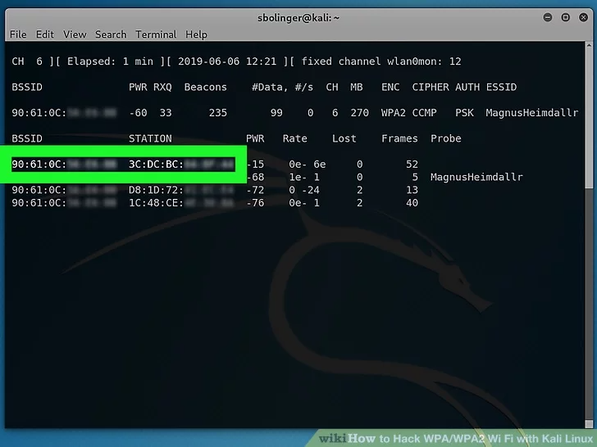
Wi-Fi WPA/WPA2 How works a WPA/WPA2 password cracking?
https://www.linkedin.com/company/wocsa/ https://www.youtube.com/@WOCSA-rx2mn/
3. Monitor the network for a handshake
4. Deauth a client (optional)
5. Capture a full handshake
https://github.com/wocsa

Slide 10
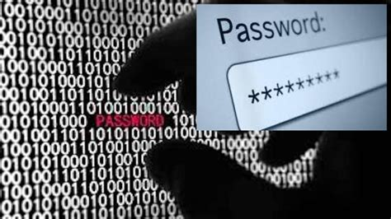
Wi-Fi WPA/WPA2 How works a WPA/WPA2 password cracking?
https://www.linkedin.com/company/wocsa/ https://www.youtube.com/@WOCSA-rx2mn/
6. Crack the password
https://github.com/wocsa

Slide 11
Why would attackers' attacks WPA/WPA2 Wi-Fi?
12/09/2024

Slide 12

Wi-Fi WPA/WPA2 Why would attackers' attacks WPA/WPA2 Wi-Fi?
https://www.linkedin.com/company/wocsa/ https://www.youtube.com/@WOCSA-rx2mn/
Access to Private Data: Breaking into a WPA/WPA2-protected network can allow attackers to intercept data transmitted over the network, such as passwords, emails, and other sensitive information.
Man-in-the-Middle Attacks: Once inside the network, attackers can perform man-in-the-middle attacks, where they intercept and potentially alter communication between devices on the network.
Network Control: Gaining access to the network allows attackers to use it for malicious purposes, such as launching distributed denial-of-service (DDoS) attacks, spreading malware, or using it for illegal activities.
https://github.com/wocsa

Slide 13
How to protect yourself from WPA/WPA2 password cracking attacks?
12/09/2024

Slide 14










Join us to change the digital world: https://www.helloasso.com/associations/wocsa/adhesions/bulletin-d-adhesion-2 Please provide your feedback for our quality check process: https://www.wocsa.org/qcheck.php
12/09/2024
www.wocsa.org
@wocsa
@wocsa_asso
@wocsa
contact@wocsa.org
Join Us!
@WOCSA-rx2mn
https://discord.gg/pDunje3tpb

